Slide 1
The Enlightenment of Age Science over Superstition
Paul Spector MD
Notes:
Revolution equal to advances in PH last century that allowed 30 additional yrs of life

Slide 2
What Is Aging?
A gradual process that converts young, healthy, fertile adults
into less healthy, infertile, older ones with an increasing
risk of dysfunction and death.

Slide 3
Aging Is A Disease
Symptoms
Cardiovascular disease
Stroke
Cancer
Dementia
Osteoporosis
Type II Diabetes
Sarcopenia
Parkinson’s disease

Slide 4
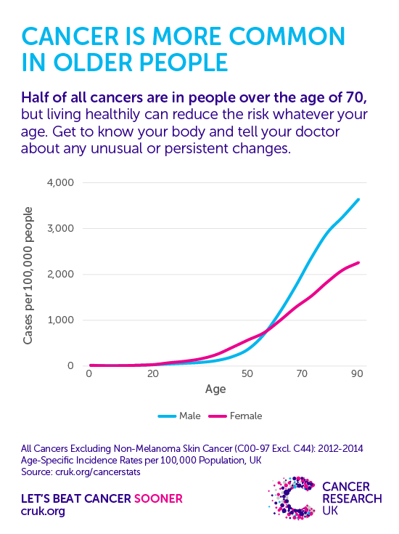

Slide 5
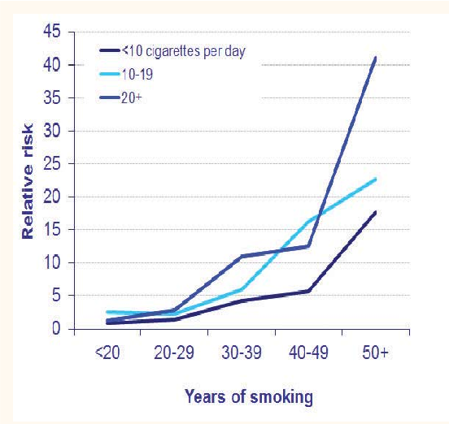

Slide 6
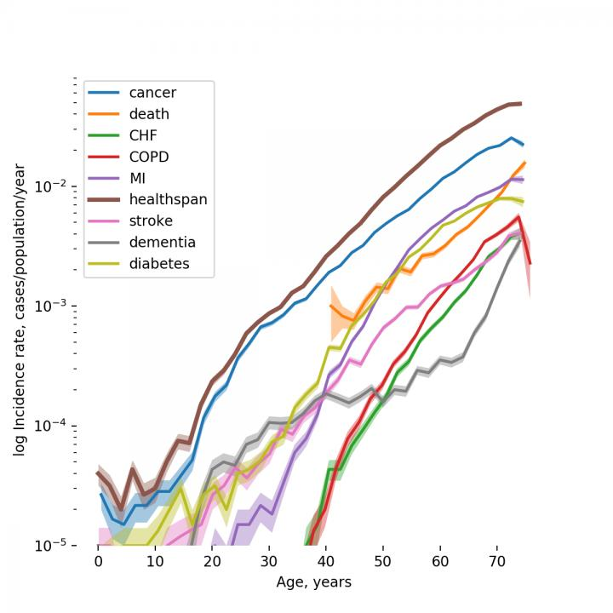
PrintEmail App

Slide 7
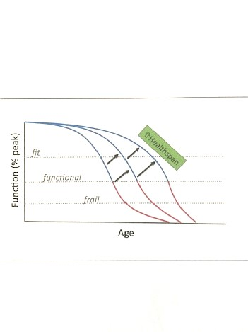

Slide 9
Longevity Dividend
If we target the biology of aging we can delay cancer, CVD, CVA, Alzheimer’s, Diabetes, Parkinson’s, osteoporosis, sarcopenia, dementia, cataract…
The economic value of delayed aging is estimated to be $7.1 trillion over 50 years.
Goal: not life extension – health extension
Whack-a-mole approach promotes extended morbidity

Slide 10
Why Do We Age?
Disposable Soma Theory
Always limited resources
Not enough energy for both reproduction and longevity
Either breed fast and die young or breed slow and maintain soma (body)

Slide 11
Why Do We Age?
Nothing in biology makes sense except in the light of evolution
Antagonistic Pleiotropy
Genes that have negative effects at later ages (after reproduction)
are not effected by natural selection.
Example: A mutation that promotes dementia, osteoporosis, cataracts before breeding would be weeded out
A mutation that even weakly increases strength/speed in young (reproductive age) would be favored even if it caused
serious illness in older

Slide 12
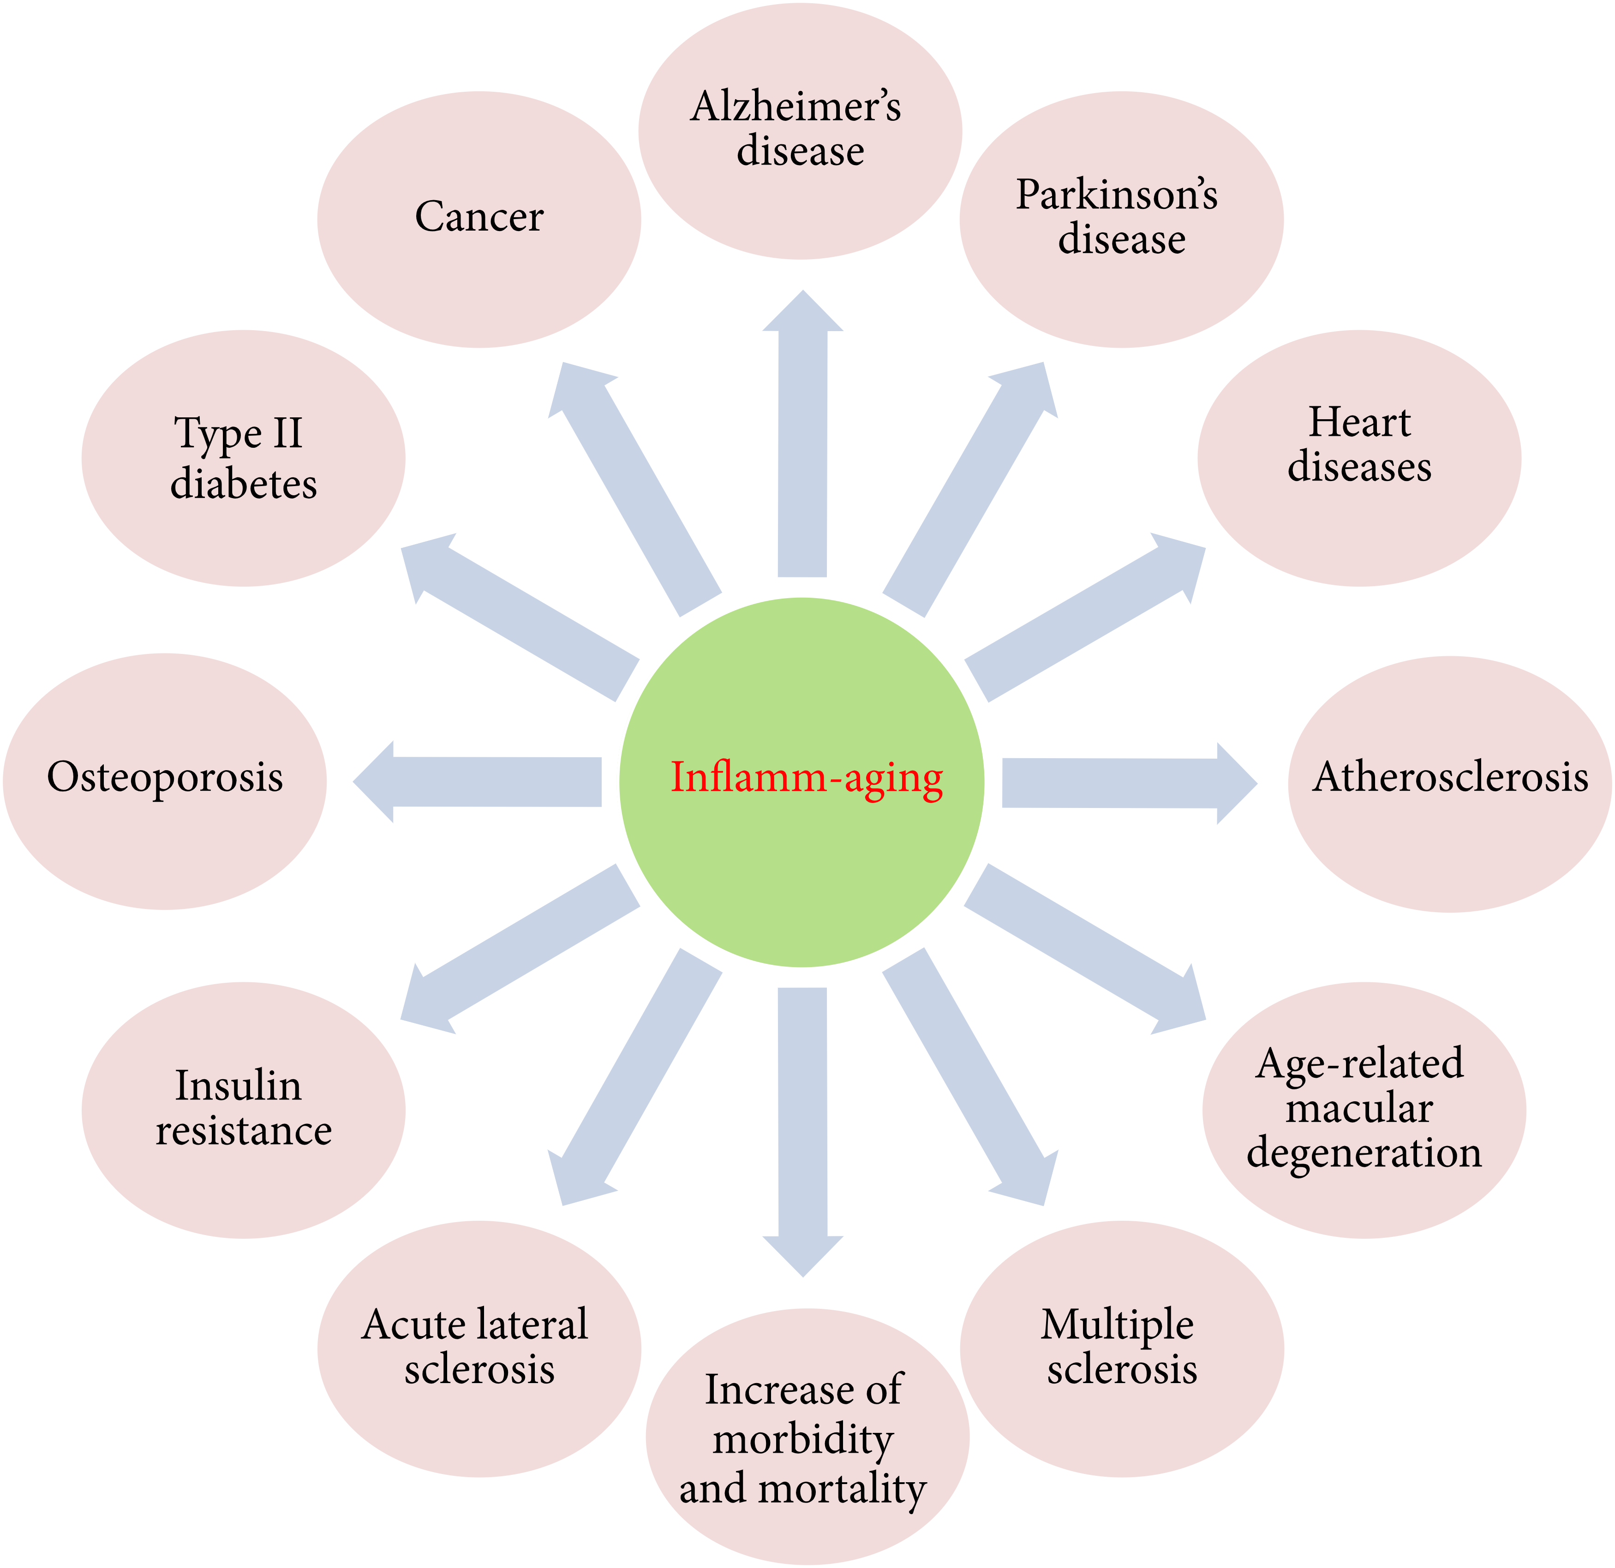

Slide 13
Why Do We Age?
Loss of Information Theory – David Sinclaire
Two types of information in biology
Genome – DNA - Computer
Epigenome - Software

Slide 14
Genome
Digital: 4 base nucleotides (adenine/guanine/cytosine/thymine)
Can be copied with great accuracy
Very stable (recovered and read from Neanderthal remains)
Natures information storage for billions of years

Slide 15
Epigenome
Analog
Genome as piano
Each gene a key
Each key produces a note
Epigenome as pianist
Chooses which keys to play
Pianist’s mistake not a problem with the piano
Directs assembly and maintenance of a human
Single fertilized egg turns into 26 billion cell newborn
Epigenome allows genetically identical cells to become different types of cells (skin/muscle/bone…)
Can be changed easily in response to environmental changes - degrades over time

Slide 17
Loss of information Theory
Aging is epigenetic noise caused by insults to the cell.

Slide 18
Why?
Mouse – 2 years
Porcupine – 18 years
Bat – 30 years
Naked mole rat – 30 years

Slide 19
Safety
Nature invented the backbone once, the hand once, hair once
but figures out longevity again and again whenever a species
stumbles into a safe niche that mitigates risk and offers a payoff
for decelerating aging.
In other words, aging is subject to regulation.

Slide 20
Negligible Senescence
Organisms that do not exhibit evidence of biological aging
reductions in reproductive capacity
functional decline
rising death rates
Naked mole rat (30)/Rockfish (200)/Greenland shark (500)

Slide 21
Naked Mole Rat
Maintains body composition
No decline in fertility
No increase in age-related mortality
Death occurs with equal frequency at all ages until close to maximal lifespan
Sickness rare
Cancer never observed
No change in BMR, insulin sensitivity, vascular and bone health
High levels of oxidative stress with no impact on longevity/function (repair/removal)

Slide 22
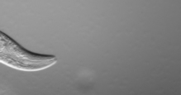

Slide 23
Aging Research A Young Science
Until 1980s – wear out like old car
Cynthia Kenyon UCSF 1993
C. elegans – worm the size of a comma, 3 week lifespan
Mutation in one gene (daf-2) doubled lifespan
Daf-2 gene encodes a hormone receptor for insulin/IGF-1
Insulin/IGF-1 promote nutrient uptake and growth
Same mutation operates in flies, mice and humans –
evolutionarily conserved

Slide 24
How does it work?
Daf-2 turns on FOXO genes
FOXO upregulates
Antioxidant genes
DNA repair genes
Immune system genes
Slows rate of aging
Promotes long health span
resistance to diseases of aging

Slide 25
Evolutionary Rational
Favorable Conditions
Food available
Low stress/Safe
Insulin/IGF-1 signaling turned on
Food storage/growth/reproduction
Unfavorable Conditions
Limited food supply
High stress
Low Insulin/IGF-1 signaling
FOXO triggers cell protection/repair and stress resistance that increase survival/health span
Reproduction turned off – neither parent nor progeny would survive

Slide 26
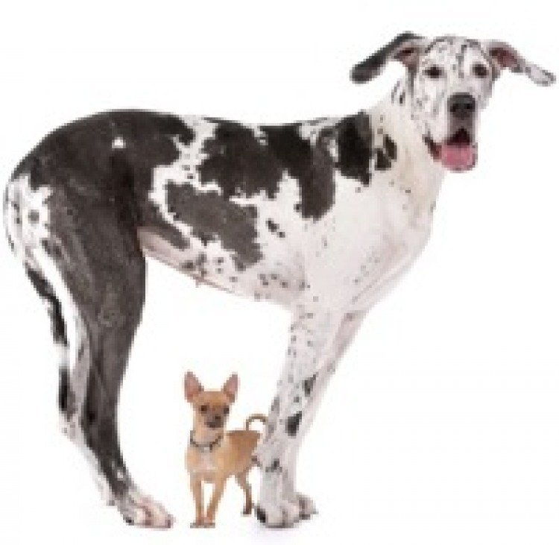

Slide 27
The Tall and The Small
Aristotle noted larger animal species longer lived
Within species appears to be the opposite
Dogs
Greater diversity in size than any other terrestrial vertebrate
Great Dane 5-7 years Chihuahua 20 years
Small dogs long-lived due to IGF-1 mutation

Slide 28
Survival Circuit
Stress switches animal from growth/energy storage/reproduction mode to repair/regenerate mode
Slows aging
Prevents age-related disease
Confers a survival advantage
Every living thing (plant/fungus/animal) has this circuit

Slide 29
Chronological vs Biological Age
Chronological Age
Years lived
Does not account for differences in rate of aging
Biological Age
Use of biomarkers that reflect functional capacity/health/mortality risk
Explains different aging trajectories
Necessary for measuring age acceleration/deceleration
Predicts lifespan

Slide 30
Biological Age
Measured by computational aging clocks – DNA methylation
Age Acceleration
Increased predicted bio age relative to chrono age
Associated with
age-related diseases
social variables
mental health
Premature mortality
Sensitive to specific interventions

Slide 31
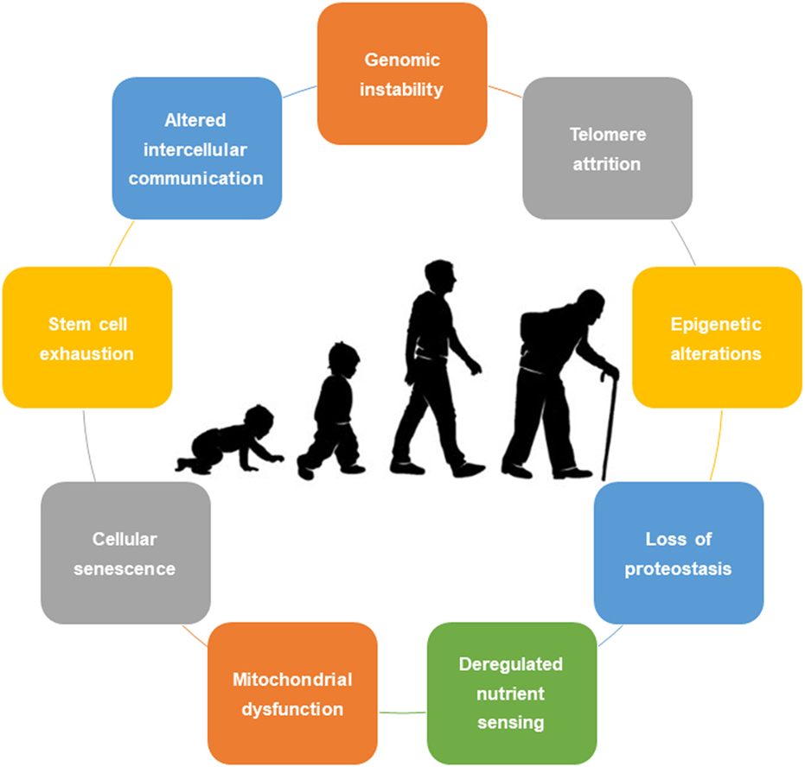

Slide 32
Turning Back the Clock
Caloric Restriction
Medication
Supplements
Lifestyles
Procedures

Slide 33
Caloric Restriction
Sufficient nutrition but ~ 25% calorie reduction
Extends lifespan/healthspan – from yeast to primates
Insulin sensitivity/BP/Inflammation
2 year human study demonstrated reduction in biological age
Very difficult lifestyle

Slide 34
Metformin
Calorie restriction mimetic
Prescribed for Type 2 Diabetes since 1960s
Diabetes is model of accelerated aging
Impaired wound healing/cataract/CVD/cancers
Diabetics on metformin up to 40% less cancer than insulin treated
2014 study - Diabetics on metformin lived longer than non-diabetics
Increases ROS activating stress defenses – prevent age-related diseases and prolongs health/life span

Slide 35
Supplements
Alpha-Ketoglutarate – suppresses inflammation
Spermidine and Glucosamine – autophagy - cellular recycling and quality control
Quercitin/Fisetin/Curcumin – senolytics - induce cell death in senescent cells
Nicotinamide riboside (NR) or Nicotinamide mononucleotide (NMN)
Vitamin D
Omega-3s
Creatine – muscle/bone/body composition
Notes:
Autophagy-

Slide 36
Lifestyle
Physical activity
Sleep duration and quality
Stress management
Mediterranean-like diet
Fatty fish
Coffee
Light alcohol consumption
Hormesis
Remember – Aging 70-80% Nurture 20-30% Nature

Slide 37
Pioneering Study
Potential reversal of epigenetic age using a diet and lifestyle intervention
Aging vol.13, Issue 7 2021 Fitzgerald et al.
8 week treatment
Diet, sleep, exercise, stress management, probiotics, phytonutrients
Significant decrease in biological age

Slide 38
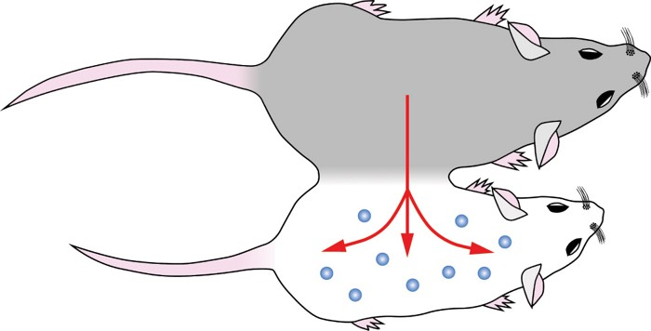

Slide 39
Parabiosis Procedure
Surgical joining of two animals circulation
1956 old-young rats joined – old rats bones transformed
1970 old-young rat pairs
older animals lived 4-5 months longer than controls (average rat lifespan 2-3 years)
First suggestion that young blood might extend longevity

Slide 40
Parabiosis Evolves
Thought regenerative capacity declines with age due to diminished responsiveness of old stem cells
But aged muscle successfully regenerated when grafted into muscle in young host
And regeneration impaired when young muscle grafted into aged host

Slide 41
Parabiosis
Question – Do systemic factors promote successful regeneration in young animals and inhibit it in old animals?
If so, old tissue might regain youthful regenerative function through systemic influences.
2005: Young blood appeared to reverse aging.
Massive push to identify specific factors in young blood

Slide 42
Vampires Were Wrong
Inhibitory effects of old blood more powerful than benefits of young blood
Appeared that with age, detrimental proteins accumulate and that they are removed or neutralized by young blood

Slide 43
Plasma Exchange
2020- single treatment – half the plasma of an old animal replaced with salt water solution with a blood protein at normal levels equaled or exceeded rejuvenating effects of heterochronic parabiosis
Old toxic molecules removed
Molecular reversion to youthful signaling mechanisms for the return of tissue maintenance/repair and immune competence

Slide 44
Therapeutic Plasma Exchange
August 2022 same results demonstrated in humans
Human aging driven by accumulation of senescent cell products
Removal of these products by TPE
reverses biological aging
Restores youthful regenerative potential
Activates anticancer, immune and antiinflammatory defenses
TPE safe well tolerated and FDA approved for autoimmune and neurological diseases

